Slide 1
Analytical Reasoning
&
Non-Verbal Reasoning
(L – 1)

Slide 2
Analytical Reasoning
It involves using logic, critical thinking, and systematic approaches to identify patterns, relationships, and underlying principles within data or concepts.
  Mirror images concept
  Water images concept
  Counting of figures concept
  Matrix completion
  Drawing the relation between words (Venn Diagram)

Slide 3
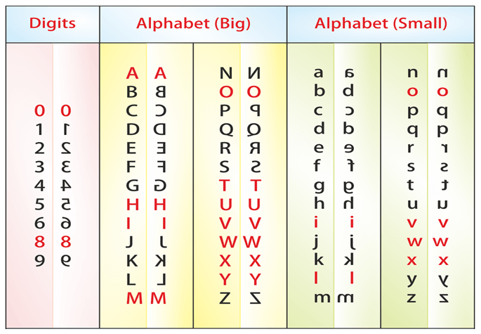
Mirror Image

Slide 4

a) 1 b) 2 c) 3 d) 4
Mirror Image
1. Choose the alternative which closely resembles the mirror image:
Notes:
Option :4

Slide 5

Mirror Image
2. Choose the correct figure of a mirror image
a) A b) B c) C d) D
Notes:
Option B

Slide 6
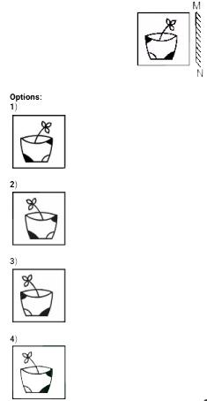
Mirror Image
3. If a mirror is placed on the line MN, then which of the answer figures is the right image of the given figure?
Notes:
Option 2

Slide 7
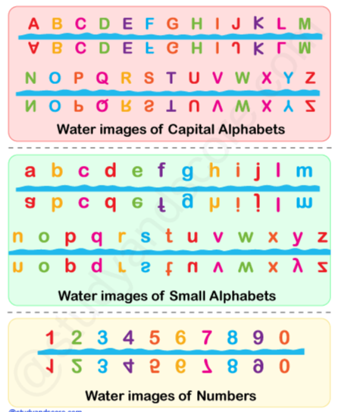
Water Image

Slide 8

Water Image
4. Choose the alternative which is closely resembles the water-image of the given combination.
a) 1 b) 2 c) 3 d) 4
Notes:
Option 4

Slide 9
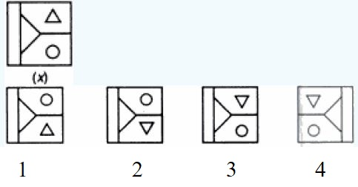
Water Image
5. Choose the correct water image of the question figure, from the given answer figures (assume that water is along XY)
Notes:
Option 2

Slide 10
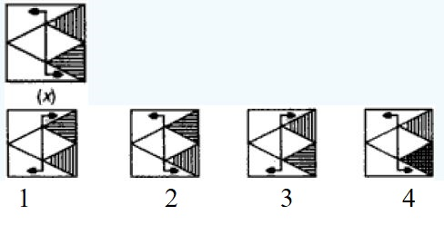
Water Image
6. Choose the correct water image of the question figure, from the given answer figures (assume that water is along XY)
Notes:
Option 1

Slide 11
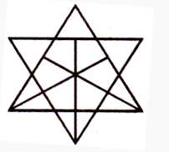
Counting Figures
7. How many triangle is in the given figure?
A. 27 | B. 29
C. 30 | D. 36
Notes:
Answer: A)

Slide 12
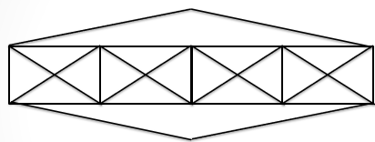
Counting Figures
8. Find the number of triangle in the given figure.
A. 32 Triangles | B. 40 Triangles
C. 28Triangles | D. 30Triangles
Notes:
Correct option: B

Slide 13
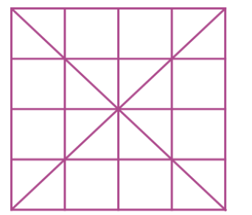
Counting Figures
9. How many squares in the figure?
A. 16 | B. 18
C. 25 | D. 30
Notes:
Correct option: D

Slide 14
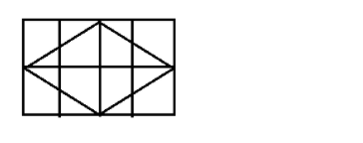
Counting Figures
10. Find the number of rectangles?
A.31 | B. 18
C. 20 | D. 24
Notes:
Correct option: A

Slide 15

Counting Figures
11. Minimum number of straight lines required to form the below figure ?
A. 10 | B. 14
C. 18 | D. 20
Notes:
Correct option: B

Slide 16
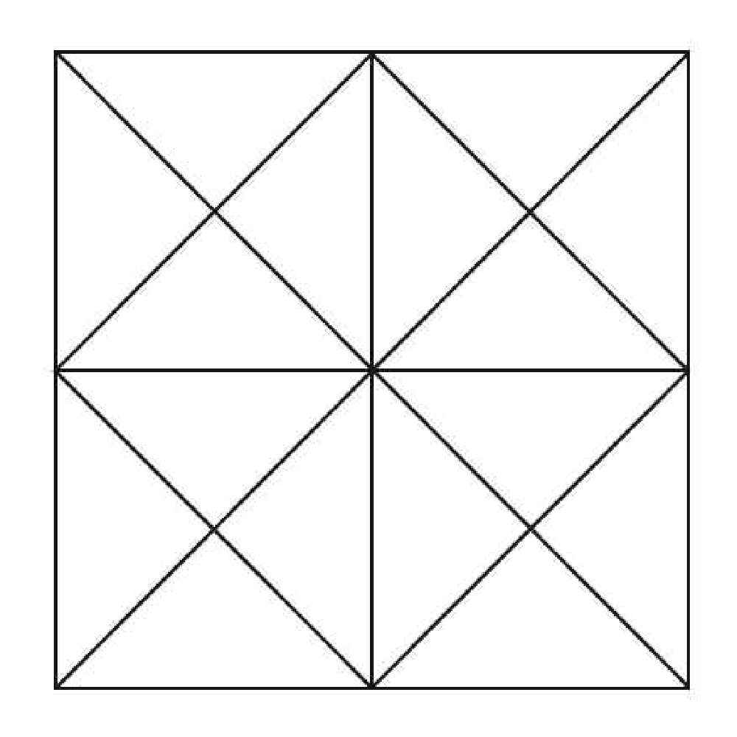
Counting Figures
12. How many triangles and squares are there in the given figure?
(a) 44 triangles, 10 squares (c) 24 triangles, 6 squares
(b) 14 triangles, 16 squares (d) 24 triangles, 9 squares
Notes:
Option a) 44 triangles, 10 squares

Slide 17
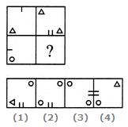
Matrix Completion
13. Select a suitable figure from the four alternatives that would complete the figure matrix.
Notes:
Correct Option: 3

Slide 18
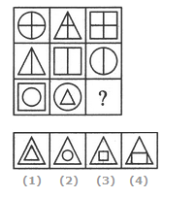
Matrix Completion
14. Select a suitable figure from the four alternatives that would complete the figure matrix.
Notes:
Correct Option: 3

Slide 19
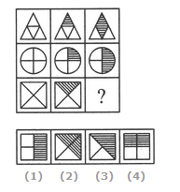
Matrix Completion
15. Select a suitable figure from the four alternatives that would complete the figure matrix.
Notes:
Correct Option: 2

Slide 20
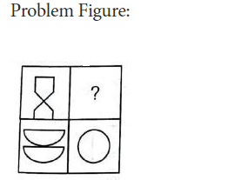
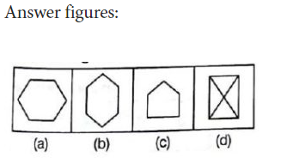
Matrix Completion
16. Select a suitable figure from the four alternatives that would complete the figure matrix.
Notes:
Correct Option: B

Slide 21
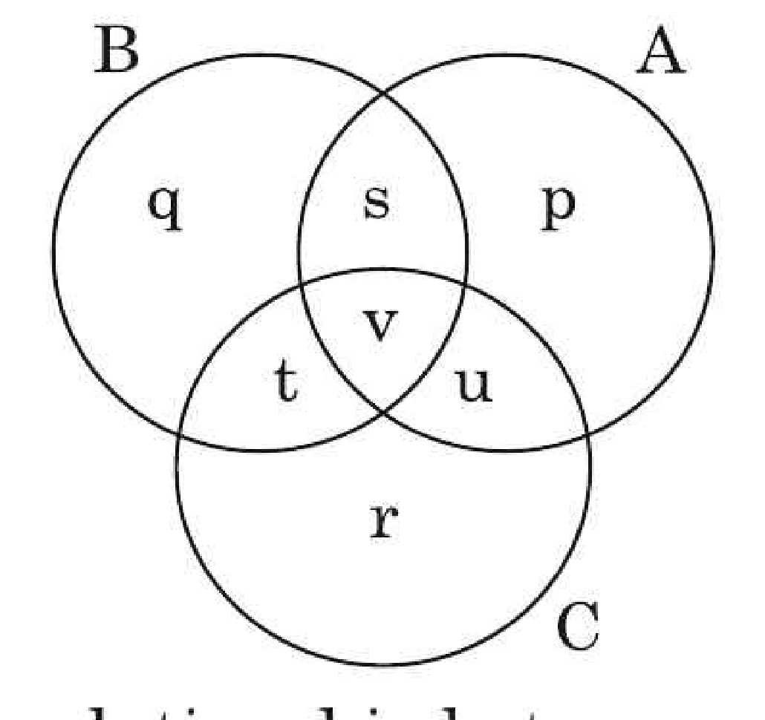
Venn Diagram
17. In the given diagram, circle A represents teachers who can teach Physics, circle B represents teachers who can teach Chemistry and circle C represents those who can teach Mathematics. Among these, which represents teachers who can teach Physics and Mathematics but not Chemistry is:
(a)v (c) s
(b) u (d) t
Notes:
Option b) u

Slide 22
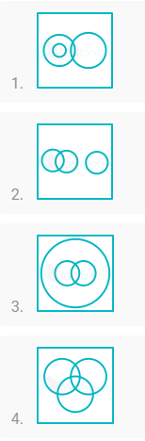
Venn Diagram
18. Which of the following diagrams indicates the best relation between Professor, Author and Infants ?
Notes:
Option 2

Slide 23
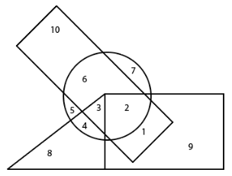

Venn Diagram
19. According to the given Venn diagram, the total number of non-athletic and disciplined boys is:
A. 5 | B. 8
C. 15 | D. None
Notes:
Option D

Slide 24
Non-Verbal Reasoning
Non-verbal reasoning is a category of cognitive assessment that evaluates an individual's ability to understand and analyze visual information and solve problems using visual reasoning. Unlike verbal reasoning, which relies on language and words, non-verbal reasoning tests involve patterns, shapes, sequences, and spatial understanding.
  Paper cutting and folding
  Finding images to complete the series
  Completion of figures
  Embedded Images
  Image grouping

Slide 25
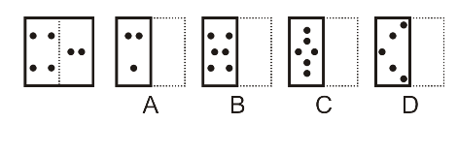
Paper Cutting & Folding
20. Find out from amongst the four alternatives as to how the pattern would appear when the transparent sheet is folded at the dotted line.
Notes:
Correct Option: B

Slide 26
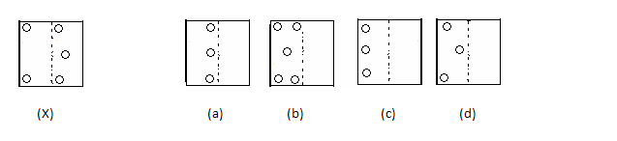
Paper Cutting & Folding
21. Find out from amongst the four alternatives as to how the pattern would appear when the transparent sheet is folded at the dotted line.
Notes:
Correct Option: B

Slide 27
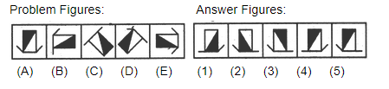
Series Completion
22. Select a figure from amongst the Answer Figures which will continue the same series as established by the five Problem Figures.
Notes:
Option 3

Slide 28
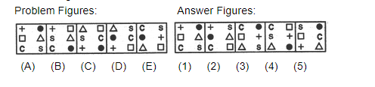
Series Completion
23. Select a figure from amongst the Answer Figures which will continue the same series as established by the five Problem Figures.
Notes:
Option 3

Slide 29
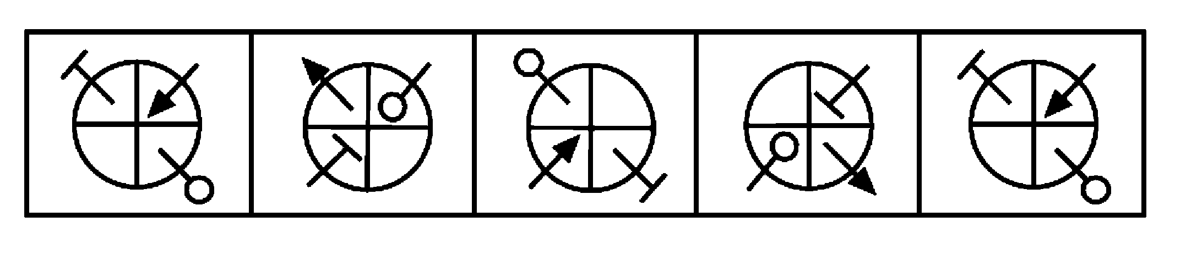
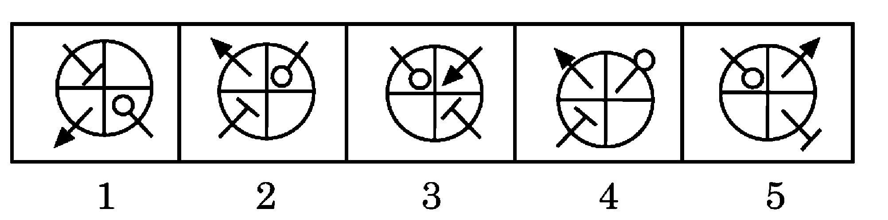
Series Completion
24. The following question consists of unmarked figures followed by five figures marked 1, 2, 3, 4 and 5. Select a figure from the marked figures which will continue the series established by the unmarked figures.
Notes:
Option 2
The elements move one step ACW and change their direction in each step.

Slide 30
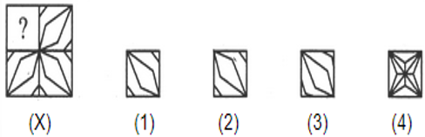
Completion of Figure
25. Identify the figure that completes the pattern
Notes:
Option 1

Slide 31
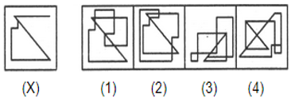
Embedded Image
26. Find out the alternate figure which contains figure (X) as its part
Notes:
Option Both 1 and 2

Slide 32
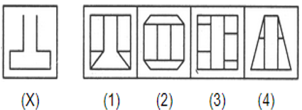
Embedded Image
27. Find out the alternate figure which contains figure (X) as its part
Notes:
Option 1

Slide 33
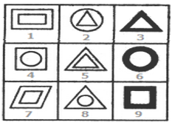
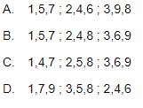
Analytical Reasoning
28. Group the given figures into three classes using each figure only once
Notes:
Option B

Slide 34
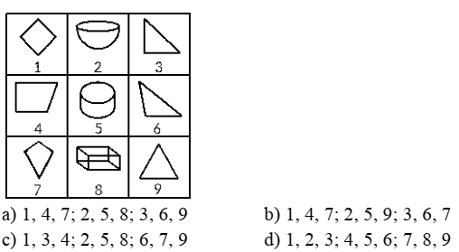
Analytical Reasoning
29. An arrangement of nine figures, which are numbered are given. Examine these figures and characterize them along with gatherings comprising of figures having more or less the same properties.
a) 1, 4, 7; 2, 5, 8; 3, 6, 9 b) 1, 4, 7; 2, 5, 9; 3, 6, 7
c) 1, 3, 4; 2, 5, 8; 6, 7, 9 d) 1, 2, 3; 4, 5, 6; 7, 8, 9
Notes:
Option A

Slide 35
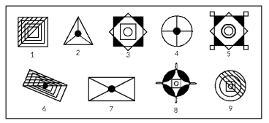
Analytical Reasoning
30. An arrangement of nine figures, which are numbered are given. Examine these figures and characterize them along with gatherings comprising of figures having more or less the same properties.
a) 2, 4, 7; 1, 6, 9; 3, 5, 8 b) 1, 3, 5; 2, 6, 7; 4, 8, 9
c) 1, 5, 7; 2, 3, 6; 4, 8, 9 d) 1, 3, 5; 2, 4, 7; 6, 8, 9
Notes:
Option A

Slide 36
Any Doubts???

